Slide 1
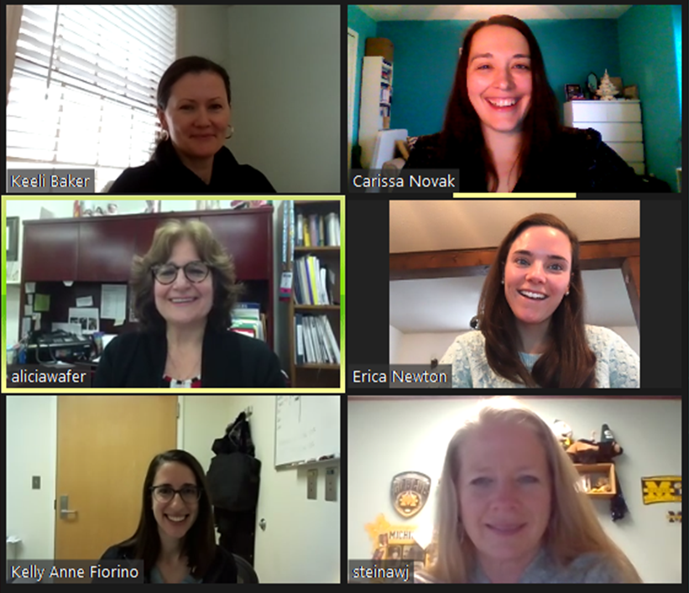
SAVE THE DATES!
MSRC is inviting you to take off your mask and join us for our Virtual 2021 Spring Conference
Tuesday, April 13th – Acute Care + MSRC Presidential Address
Thursday, April 15th – Student/Education
Tuesday, April 20th – Neo/Peds
Thursday, April 22nd – Leadership
AARC/MRSC members $30 per day or $100 for entire conference
AARC/MSRC student members FREE for entire conference
Non AARC/MSRC members $40 per day or $150 for entire conference
Non AARC/MSRC student members $35 for the entire conference
3 lectures per day. More details to come.

